Slide 1
Allegiance a Cardinal Health Company
Dominic Marturano
Randy Thompson
Notes:
Thank you for joining us so that we can share information on our company, Allegiance Healthcare Corporation. I am (name) and I work at Allegiance as a (job title). I have been with the company for (# of Years) and am a (graduate of this university). Joining me in this presentation is (let other presenters introduce self in same way). During the next hour our goal is to provide you with the following : (read slide)

Slide 2
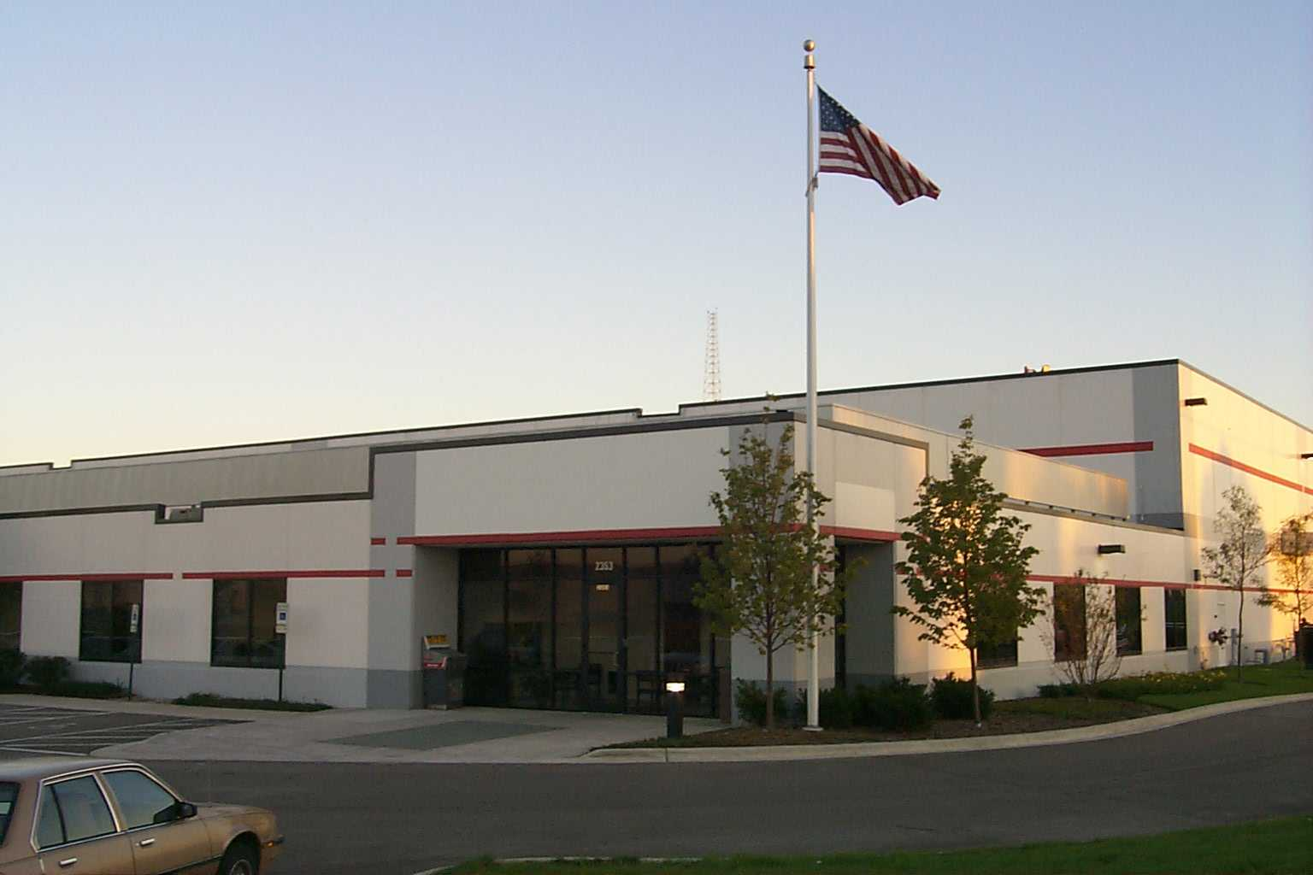





Cardinal Health Overview
Health-Care Manufacturers
Health-Care Industry Service Provider
Health-Care Providers
Patient
Distribution Services
Marketing and Sales Services
+
Operations and Clinical Improvement Services
Product Development Manufacturing and Packaging Services
+
+
Cardinal Health is a Vital Link Between Manufacturers and Providers of Patient Care

Slide 3

Cardinal Health Today
Leading Diversified Healthcare Services Company
Annual Revenues of $26B
Market Capitalization of $16B
40,000 Employees
Diversified Earnings Stream
Med/Surg Mfg. & Dist.
Rx Distribution
29%
38%
Rx Services
Operating Earnings Mix -- FY99
33%

Slide 4
Company Profile
Allegiance Healthcare Corporation
  Located 40 miles north of Chicago
  22,000+ Employees World Wide
  Subsidiary of Cardinal Health (Feb 99)

Slide 5

















Cardinal Health Companies
Cardinal Distribution
Medicine Shoppe
Allegiance Healthcare
Owen Healthcare
Pyxis Corporation
Comprehensive Reimbursement
RP Scherer
ScriptLINE
PCI Services
Cardinal Information Corp
Automated Liquid Packaging
Renlar Systems
National Specialty Services
Healthtouch
National PharmPak Services
MediQual
Pharmacists PRN
CORD Logistics

Slide 6
Key Initiatives
Operational Efficiency
Technology Shared Services
Corporate Vendor Strategic Partnerships
Data Center Consolidation
Data Security/Business Recovery
Strategic Initiatives
Corporate IT Planning/Processes
Acquisition/Integration Framework
e-Commerce/Application Development
Human Resource Initiatives
Recruiting/Internship/Retention
Management Development/Assessment

Slide 7
Cardinal’s Commitment to
Information Technology
Three Year
Investment Greater
than $200 Million
$250 Million
Annual IT Budget
1500+
Information
Technology
Personnel
Notes:
We understand information - it has been core to our company from day one.
As in the past, we have leveraged technology to help our customers and suppliers. We view the Internet as the next evolution in our journey to further extend our services in the supply chain.

Slide 8
IT Core Competencies
Candidates evaluated on several levels
  Technical Skills
  Business Acumen
  Customer Focus
  Flexibility / Adaptability
  Leadership Skills
  Interpersonal Skills
  Learning Application
  Maturity
  Process Orientation
  Results Orientation
  Teamwork

Slide 9
Training Programs
Initial Orientation
Individual Development Plan
  Technical Needs
  “Soft Skill” Needs

Slide 10
Entry-Level Positions
5 Different Job Categories
  Integrator / Generalist
  Business Analyst
  Technical Specialist
  Service Specialist
  Leader

Slide 11
Advancement Potential
Movement Within Job Categories
Movement Within Allegiance
Movement Within Cardinal

Slide 12

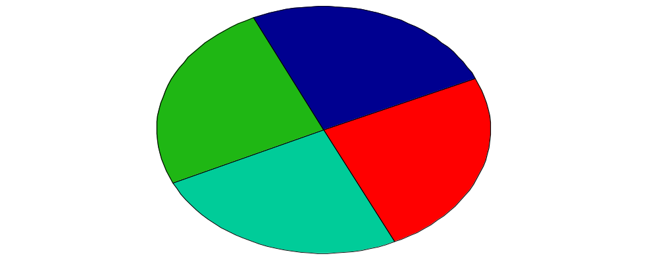
Compensation
Work
Environment
Base Salary
Merit Pay
Incentive pay
Principles & Purpose
Work/Life Balance
Meaningful Contribution
Recognition
Development
Career Opportunities
Job Content
Performance Feedback
Continued Learning
Benefits
Health & welfare
Retirement
Company Ownership
Notes:
These elements together comprise our total rewards practices at Allegiance.

Slide 13
INFORMATION TECHNOLOGY HIGHLIGHTS
ComputerWorld Honors "Premier 100 IT Leaders for 2000" - Kathy White
Information Week named our E-Business system on "Top 100 Electronic-Business Innovators" List
Cardinal announces participation in the formation of an Internet-based company as part of a healthcare industry exchange
The American Productivity and Quality Center (APQC) Award Recognition for Enterprise-Wide Implementations
CIO Magazine named our ValueLink Systems Application as one of the 12 most innovative IT applications in the last decade
Notes:
In this section of the orientation, we will give you an overview of Allegiance. We will cover:
- Our company profile. Our leadership position in the marketplace & our rich heritage.
- Dynamics of the health care industry. Our role and our dedication to improving health care through excellent service to our customers.
- Our Company Key Messages
- Our businesses & long-term strategies
- Our worldwide facilities, locations, U.S. regional sales areas
- Our leaders

Slide 14
A Tradition of IT Innovation
Stockless Distribution System
MediQual
ASAP
Renlar
ScriptLINE Rx
cardinal.com
1970
1980
1990
2000
Tel-American
Accunet, Network,
and OTIS
Pyxis
asap-e.com
Healthtouch
CardinalCHOICE
& CHOICE-HQ
Notes:
Cardinal’s commitment to Information Technology - a Tradition of Innovation:
$250 million in annual IT operations
Capital investments exceeding $200 million in last three years
1500+ information technology personnel

Slide 15
Cardinal Health, Inc.
Information Technology
Kathy White
Executive Vice President
and
Chief Information Officer
Jody Davids
Senior Vice President
Cardinal Distribution
Rich Gius
Senior Vice President, IT
Allegiance Distribution
David Loebig
Senior Vice President
Corporate Systems
Ken Yorgensen
Senior Vice President
Enterprise Technology
Gary Dowdy
Vice President
e-Commerce
Strategy
Gloria Keesee
Vice President
IT Manufacturing
David Lawrence
Vice President
e-Commerce
Cardinal Distribution
Neal Christian
Director
I.T. Finance
Linda Dye-Ludwig
Director
H.R. Dublin I.S.
Kathy IT Org Chart.ppt02/11/2000

Slide 16
Daily Duties
No Two Employees Positions are the Same
  Multiple Concurrent Assignments
  Different Stages of Project Life Cycles
  Networking

Slide 17
Past Recruiting
Look for 10 - 15 College Grads Per year
Currently Recruit at 4 Core Schools

Slide 18
Performance Reviews
Goals Established at Beginning of Year
Progress Reviewed Twice per Year
Annual Salary Increases Driven From Performance Review

Slide 19


